Slide 1
Digital Portfolio
STUDENT NAME: S.NARENTHIRAN
REGISTER NO AND NMID: 212403864 /0A4FF9F9729A00D8A984FE09D
DEPARTMENT: COMPUTER APPLICATION
COLLEGE: MADRAS UNIVERSITY

Slide 2
PROJECT TITLE
PERSONAL PORTFOLIO

Slide 3


AGENDA
Problem Statement
Project Overview
End Users
Tools and Technologies
Portfolio design and Layout
Features and Functionality
Results and Screenshots
Conclusion
Github Link
3/21/2024 Annual Review

Slide 4

PROBLEM STATEMENT
Problem Statement
The project addresses the need for a personal portfolio website to showcase an individual’s skills, achievements, and work in a structured, professional, and accessible way. It provides a digital platform for creating a strong personal brand.

Slide 5

PROJECT OVERVIEW
This is a simple, responsive, and visually appealing personal portfolio website that highlights personal information, technical skills, education, and completed projects. It acts as a digital resume and professional identity hub.

Slide 6

WHO ARE THE END USERS?
The portfolio is designed for recruiters, employers, clients, and educators who wish to review skills and achievements quickly. It is also useful for peers, collaborators, and networking opportunities.

Slide 7
TOOLS AND TECHNIQUES
The project uses HTML, CSS, and JavaScript for structure, styling, and interactivity. GitHub Pages or similar platforms are used for hosting, making the site easily accessible.

Slide 8
POTFOLIO DESIGN AND LAYOUT
The design is clean, minimalistic, and user-friendly, with sections for introduction, skills, projects, and contact information. A responsive layout ensures compatibility across all devices.
‹#›

Slide 9
FEATURES AND FUNCTIONALITY
Key features include a navigation bar, project showcases with descriptions, a downloadable resume, and a contact form. The site is optimized for speed and smooth navigation.

Slide 10
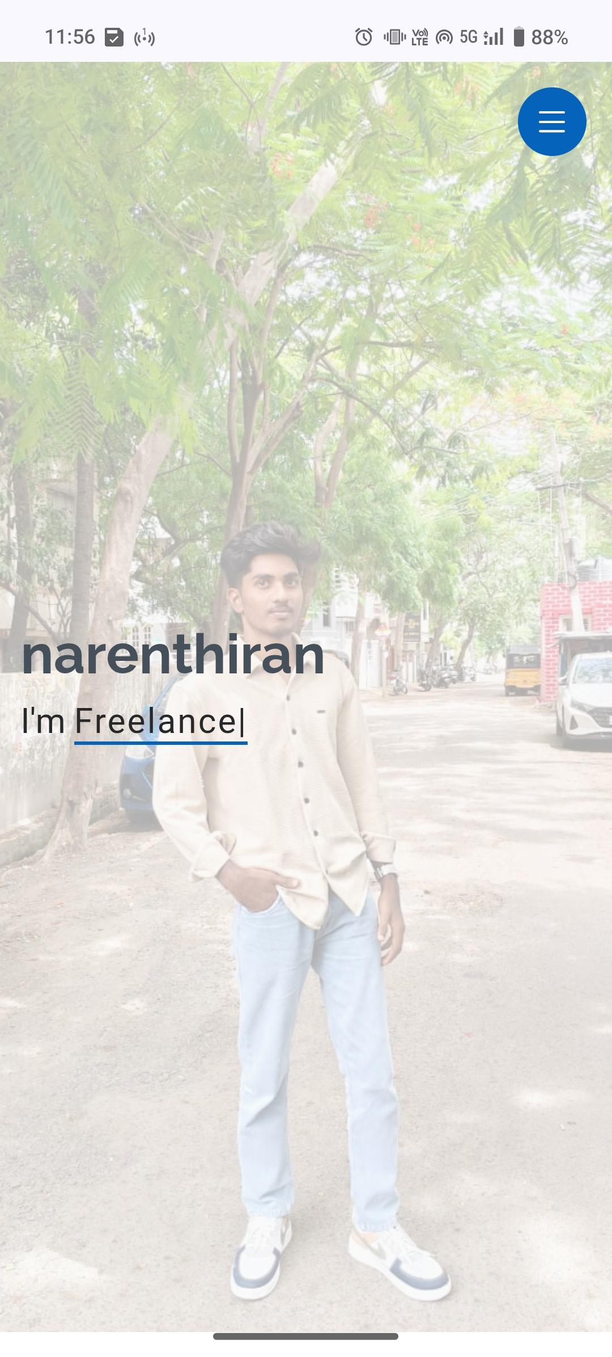
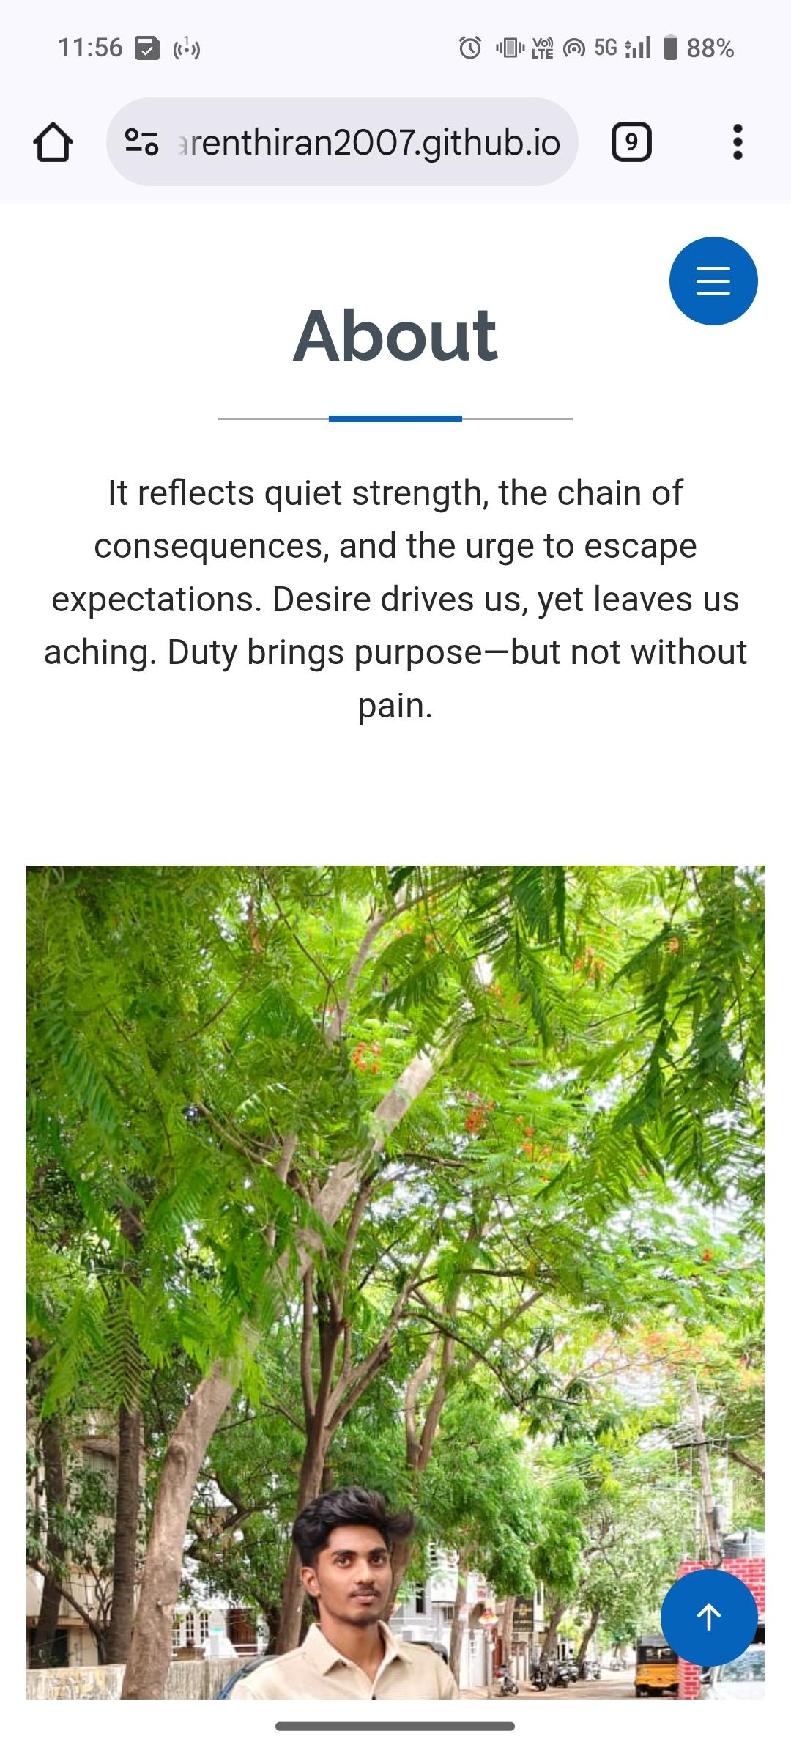
RESULTS AND SCREENSHOTS
3/21/2024 Annual Review
‹#›

Slide 11
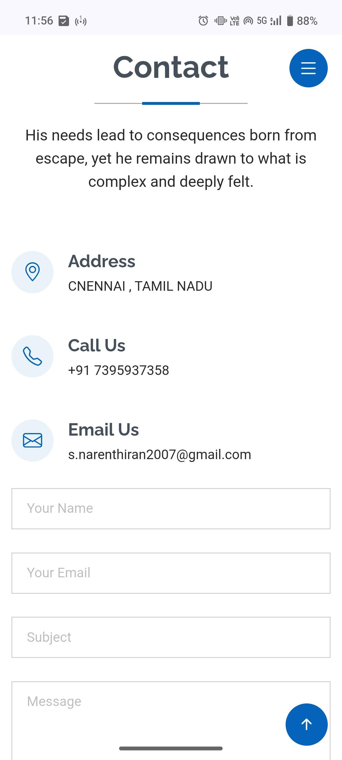
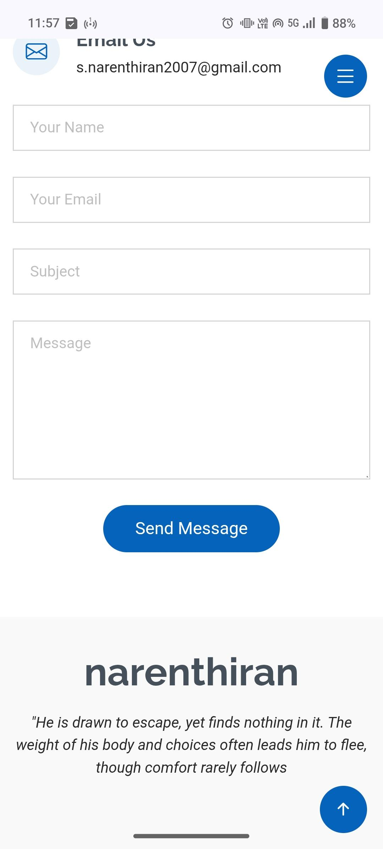

Slide 12
CONCLUSION
The portfolio successfully achieves its goal of presenting skills and projects while helping build a strong online presence for career growth and networking.
‹#›

Slide 13
GitHub link
https://narenthiran2007.github.io/Naan-Mudhalvan-Portfolio/

